Slide 1

RUNGTA COLLEGE OF DENTAL SCIENCES & RESEARCH
PREVENTIVE AND INTERCEPTIVE ORTHODONTIC
DEPARTMENT OF PEDODONTICS AND PREVENTIVE DENTISTRY

Slide 2
Specific learning Objectives
Core areas | Domain
Introduction Preventive orthodontics Interceptive orthodontics | Procedures undertaken in preventive and interceptive orthodontics.

Slide 3
CATEGORY
MUST TO KNOW
NICE TO KNOW
Checkup for oral habits
DESIRE TO KNOW
Occlusal equilibration.
Caries control
Space maintainers
Serial extraction
Space regainers
Muscle exercises

Slide 4
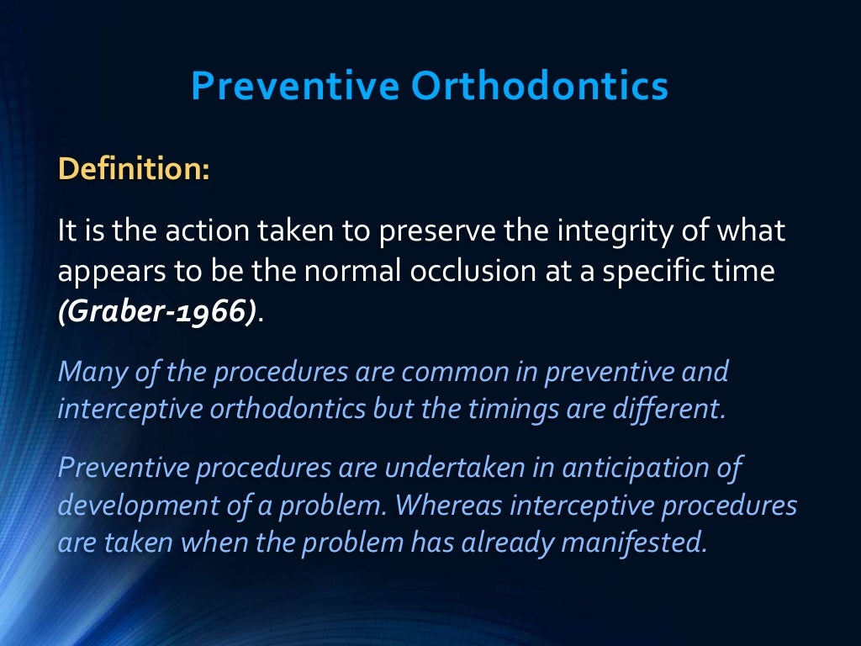

Slide 5
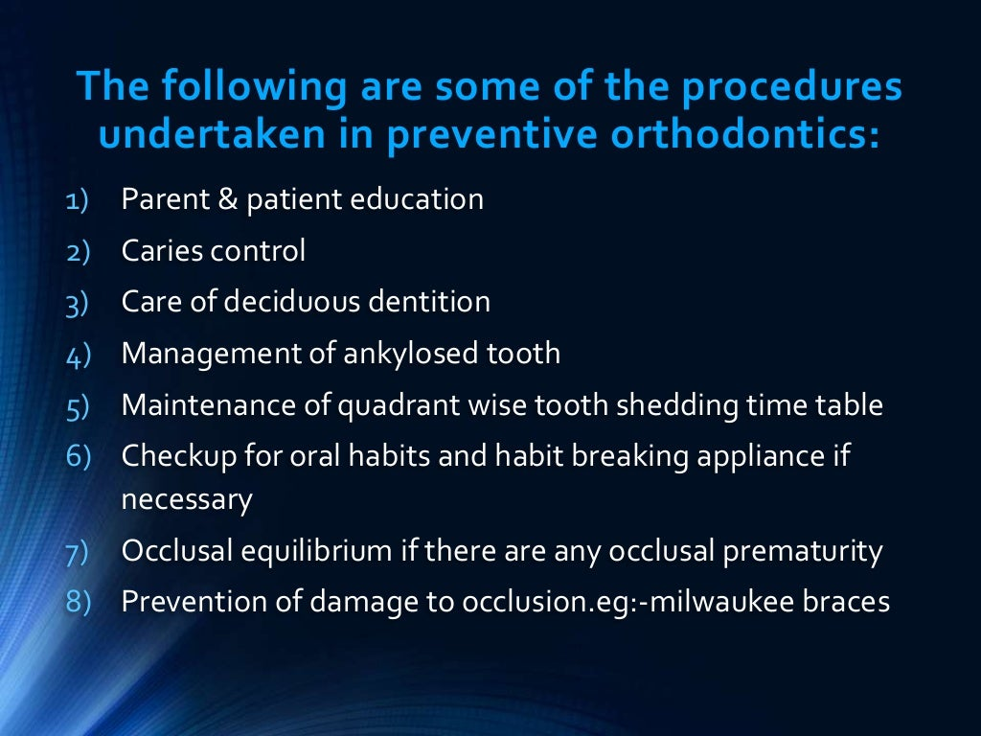

Slide 6
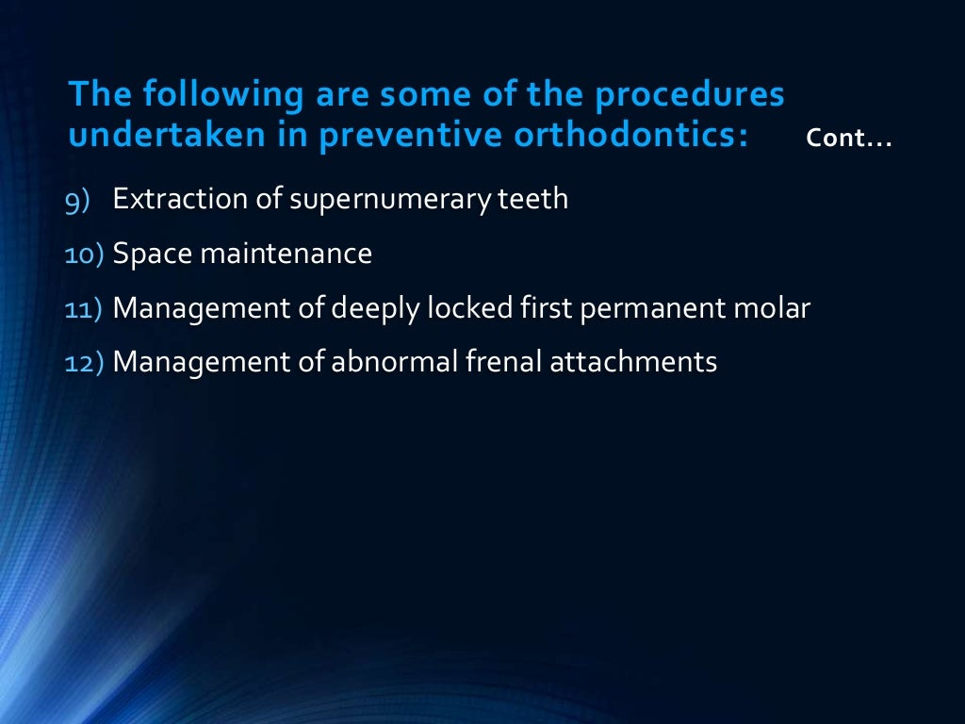

Slide 7
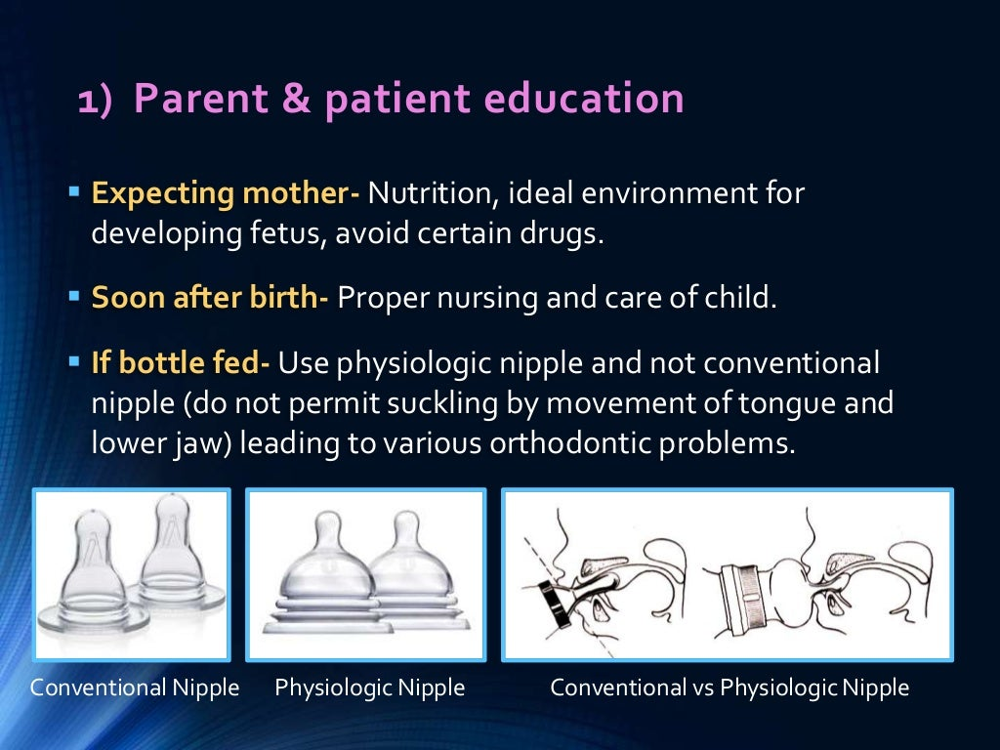

Slide 8
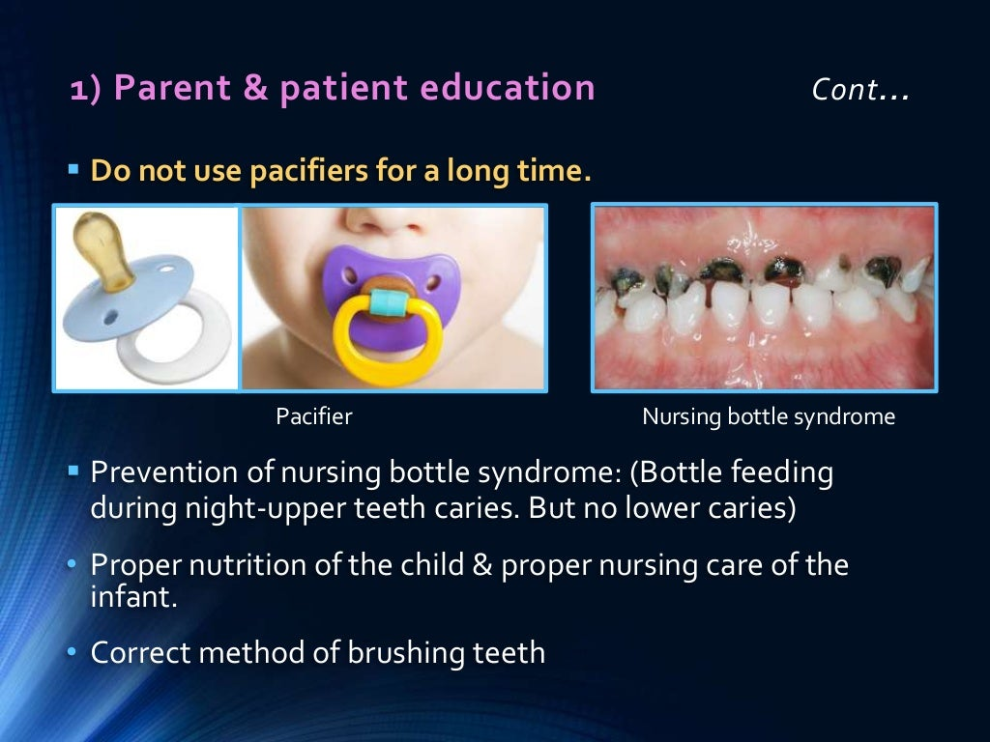

Slide 9
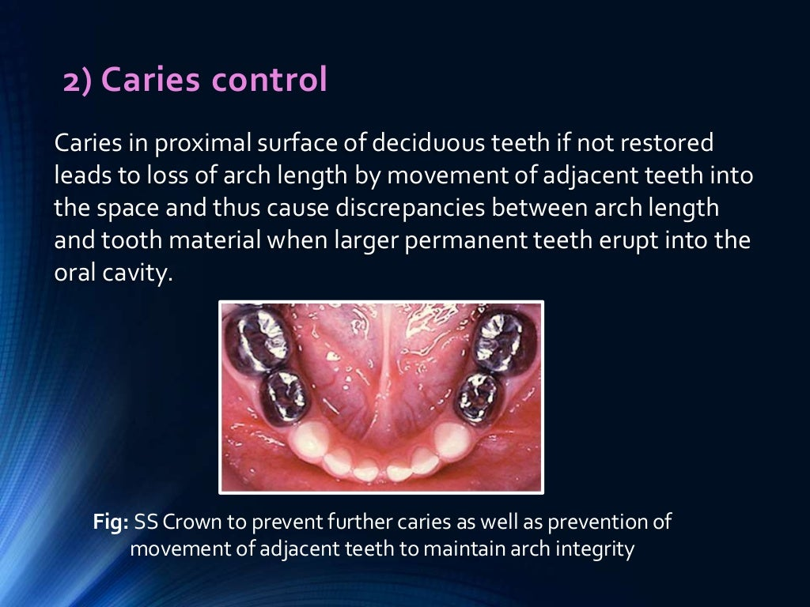

Slide 10
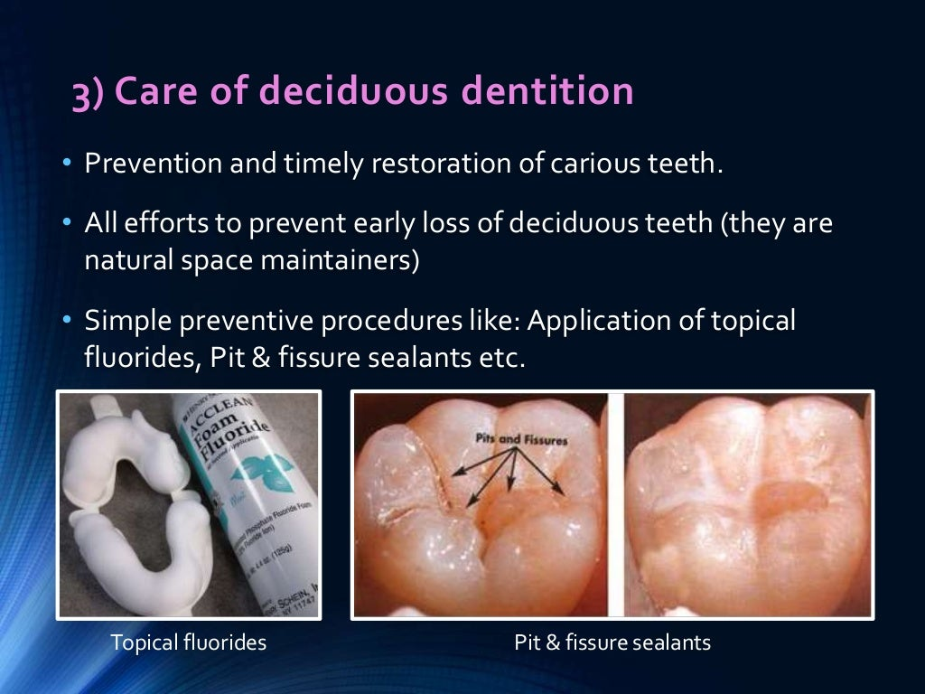

Slide 11
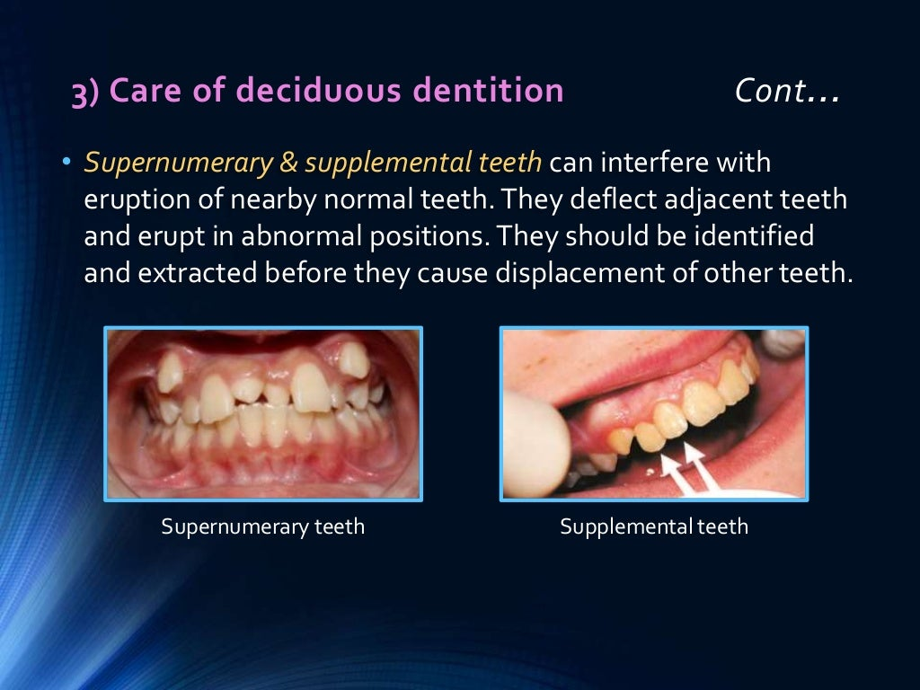

Slide 12
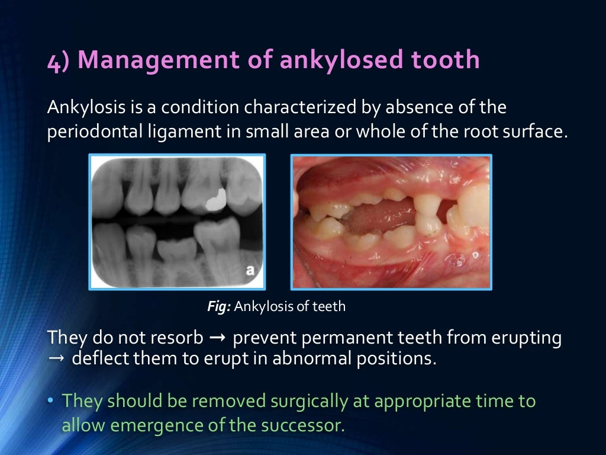

Slide 13
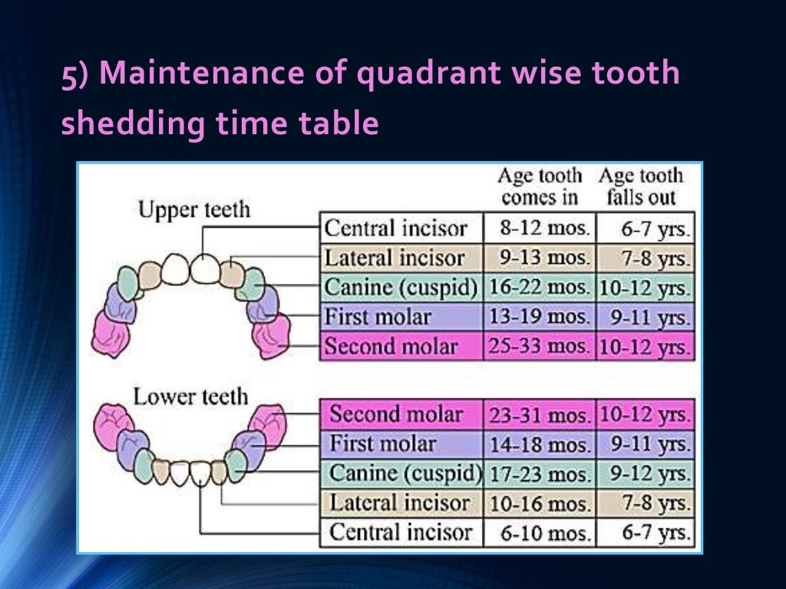

Slide 14
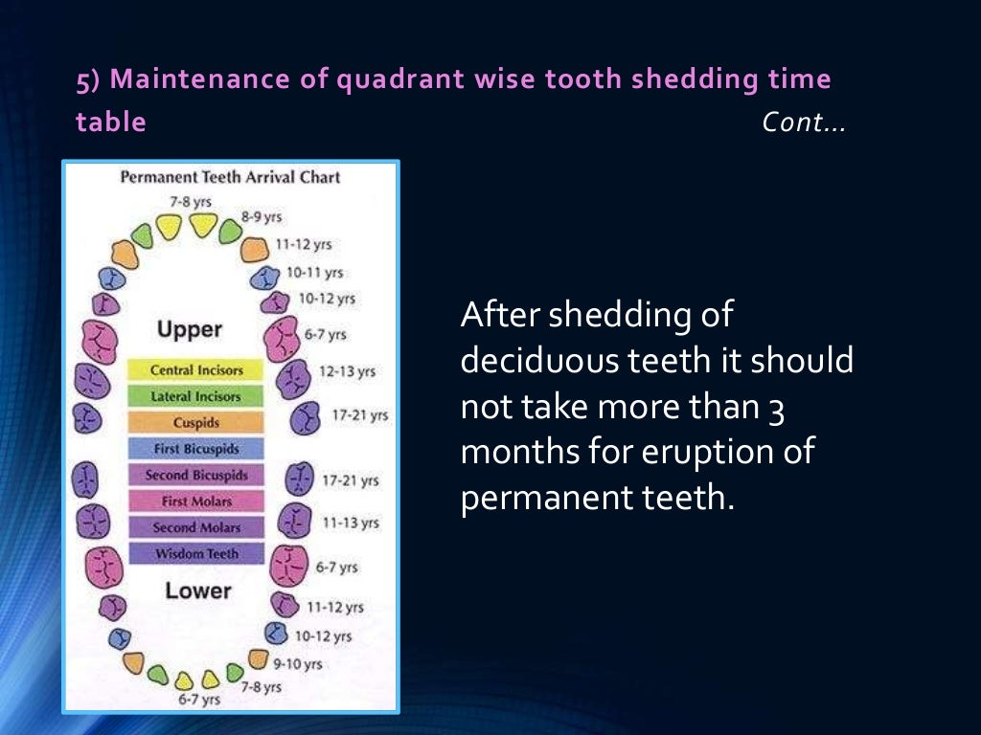

Slide 15
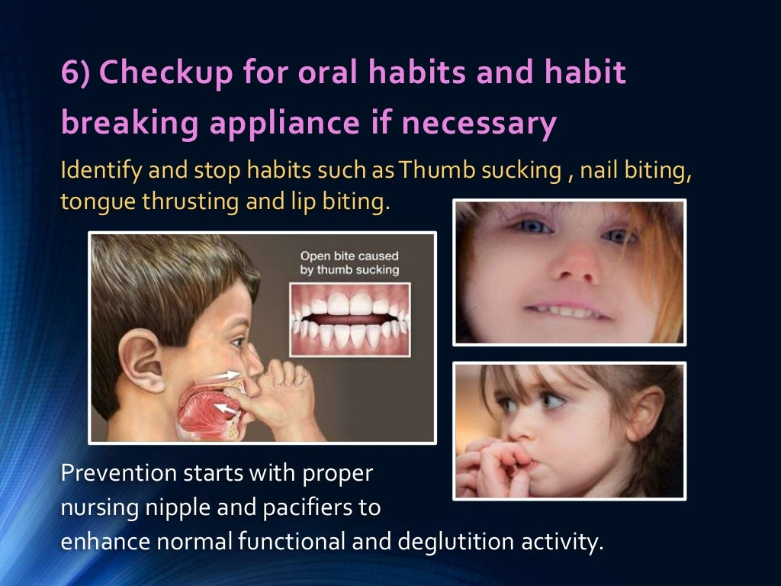

Slide 16
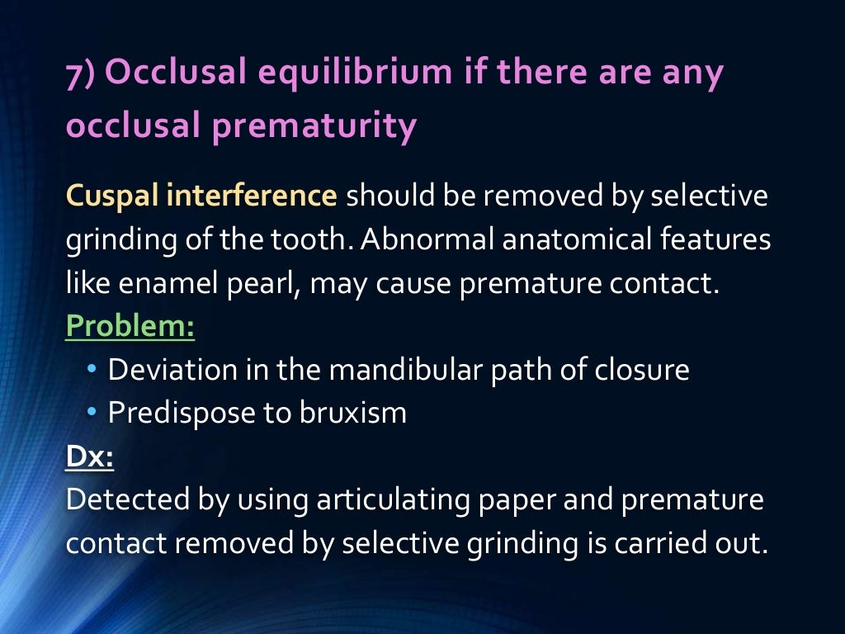

Slide 17
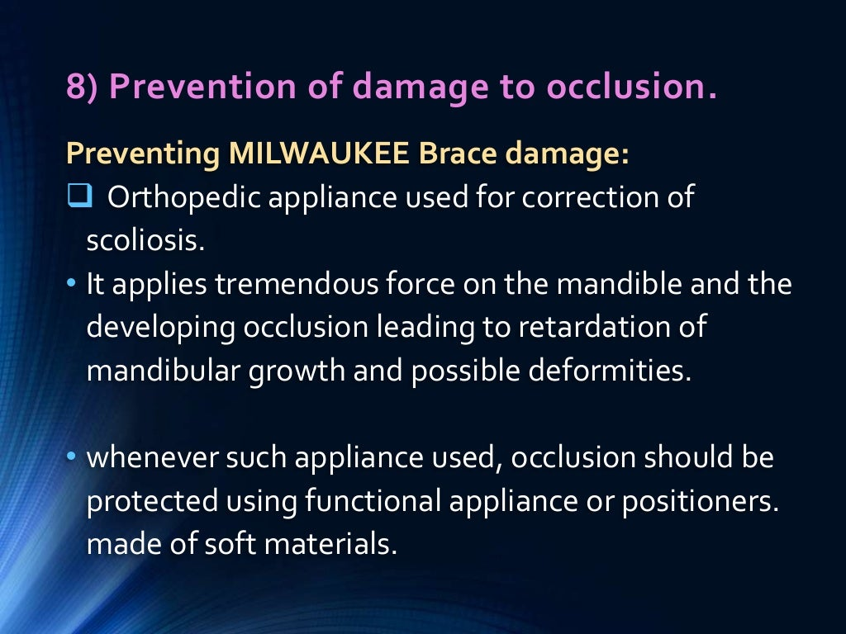

Slide 18
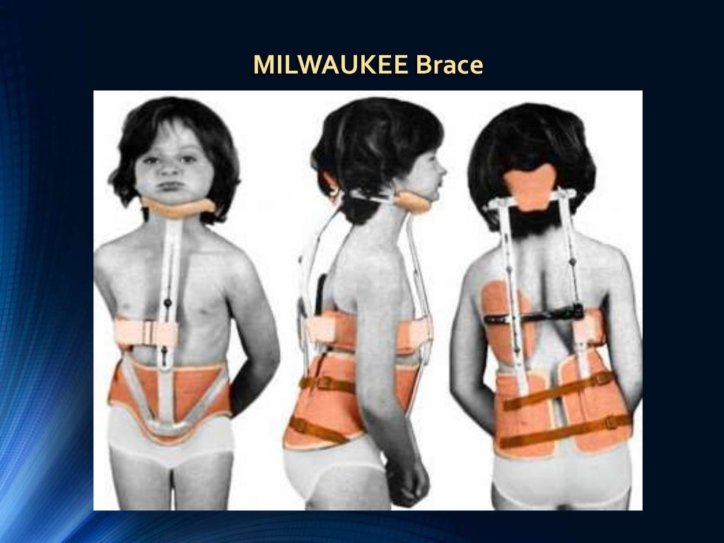

Slide 19
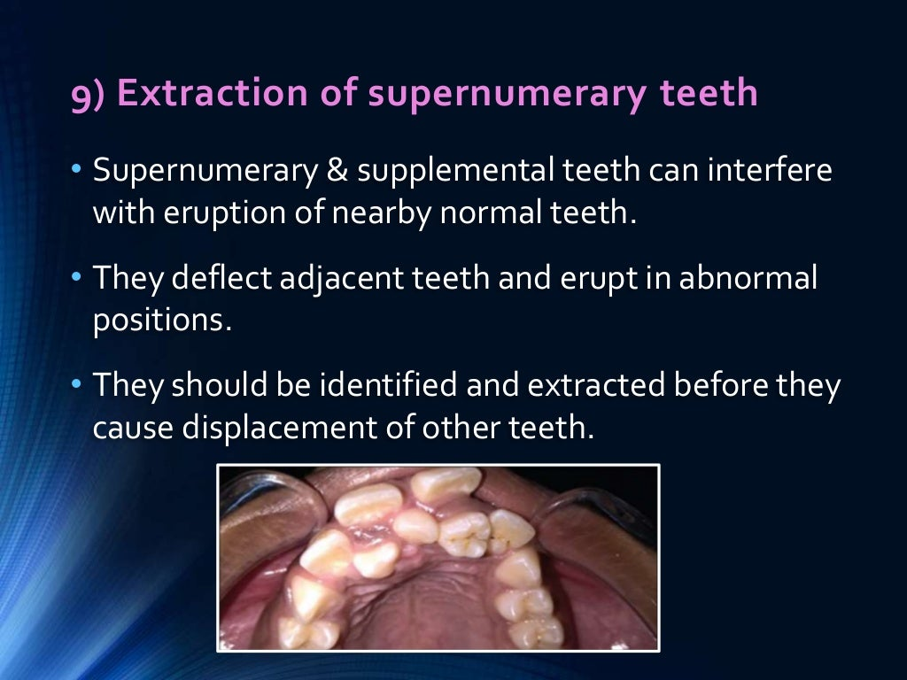

Slide 20
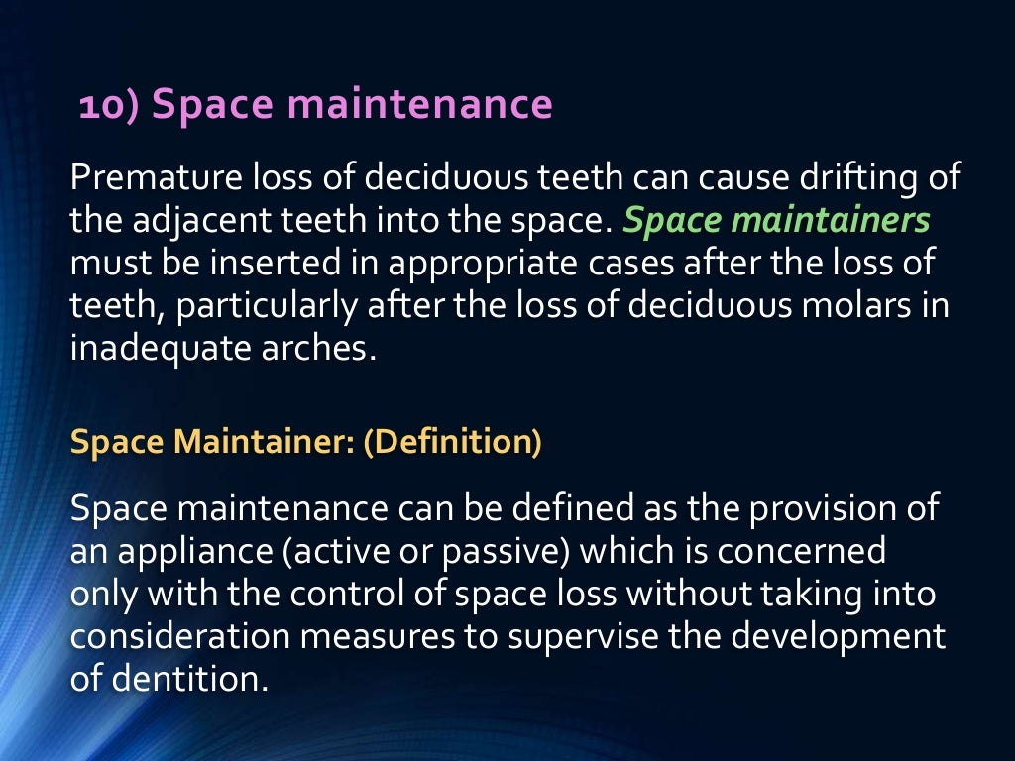

Slide 21
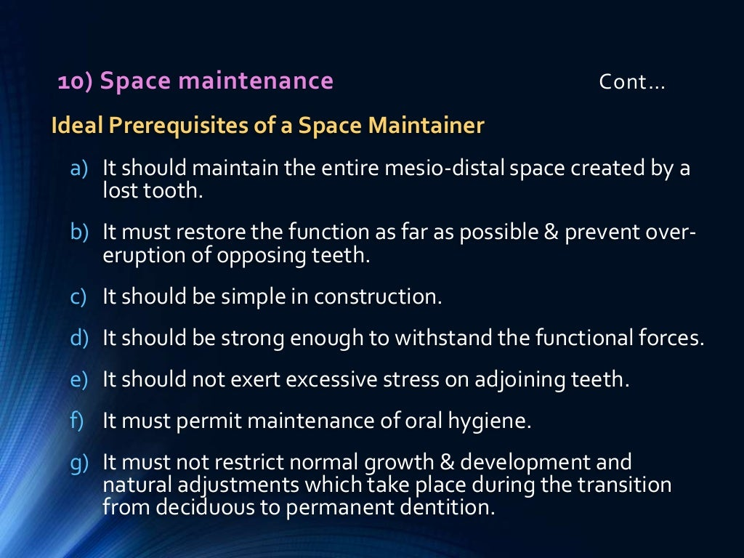

Slide 22
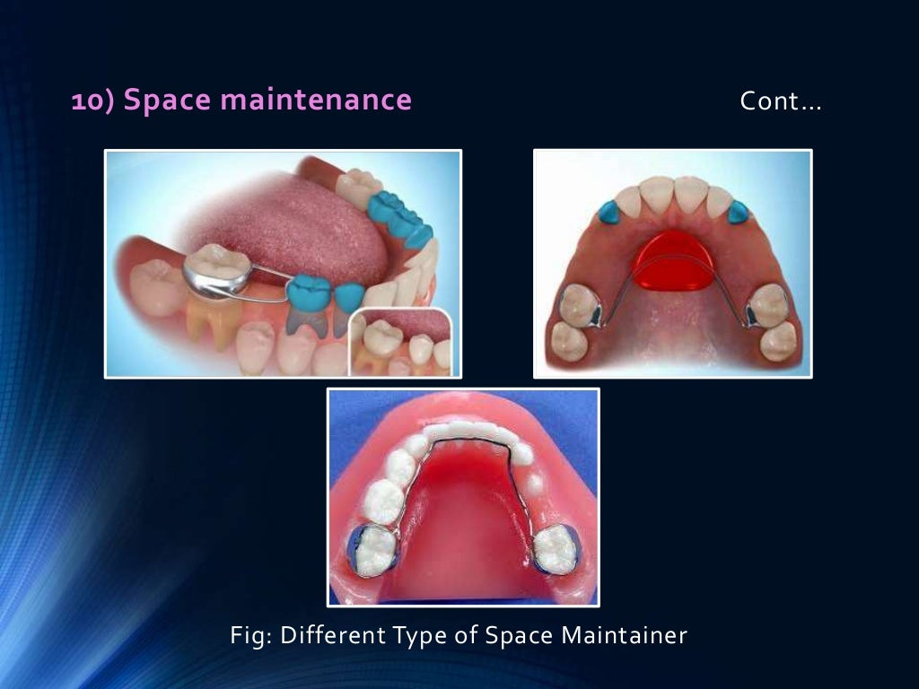

Slide 23
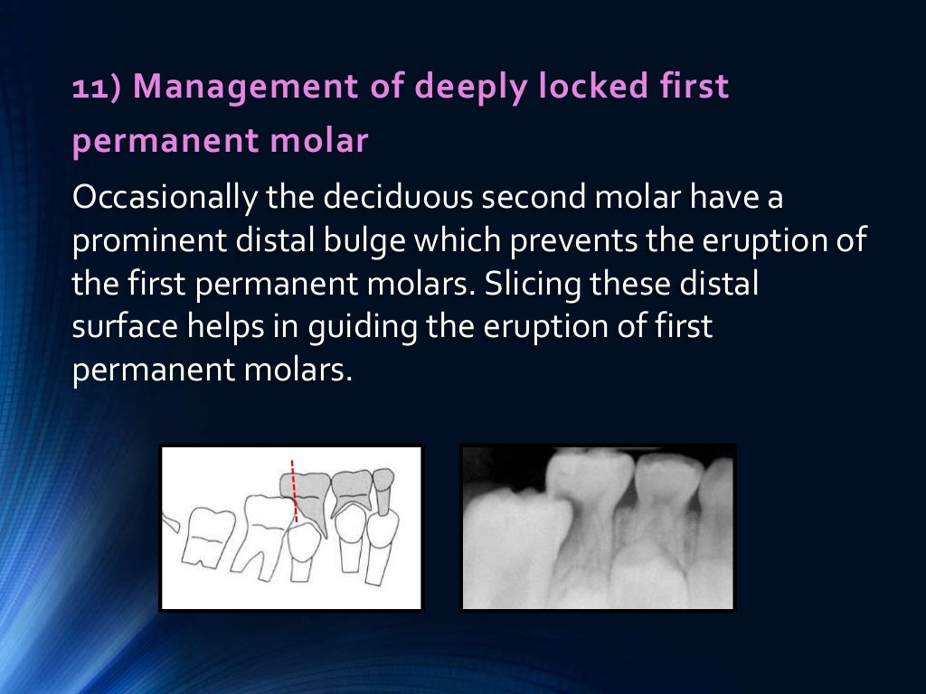

Slide 24
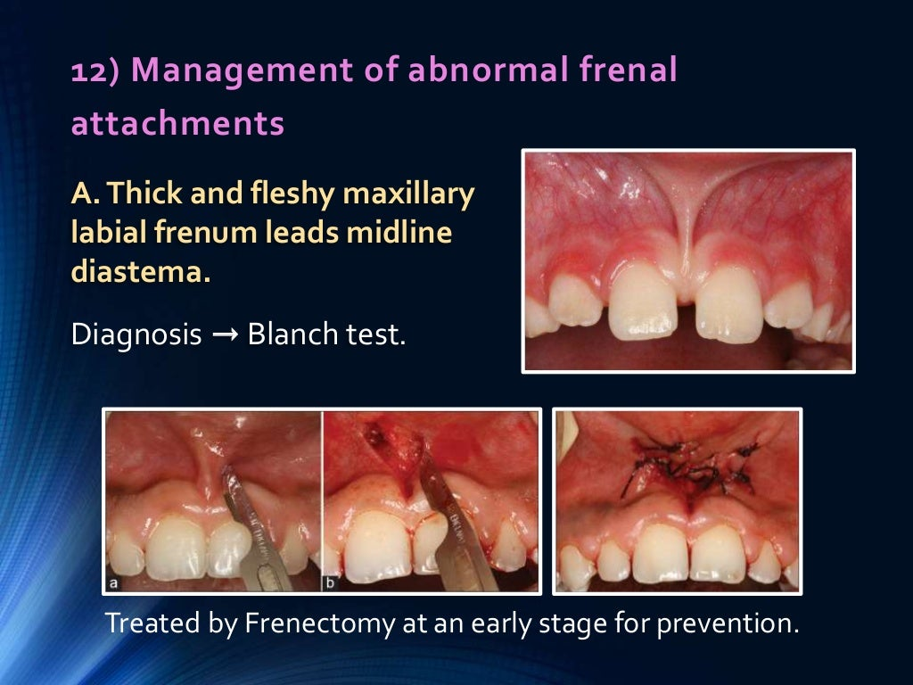

Slide 25
